Slide 1

Smart Room Controller
Created by Kalif Purce for temperature,pressure,humidity,and heat detection.

Slide 2
Concept
At home, I noticed my parents would worry about the fireplace having large amounts of heat, and not knowing if there was flames still present before leaving the house. So, I created this project for my parents to be able to tell if their fireplace is still putting out heat/flame in any amount before leaving the house. Alternatively, this design could also be repurposed outside, with a battery for campers to make sure their flame is fully out before leaving a campground and also get access to temperature and humidity without use of wifi or functioning service.

Slide 3
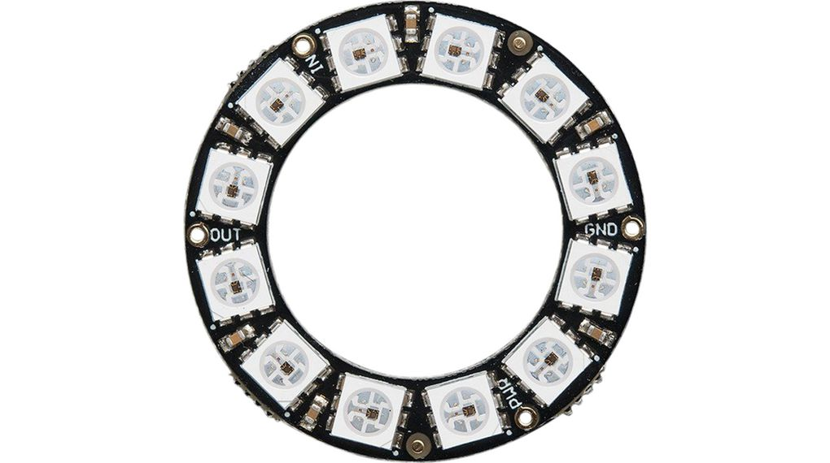
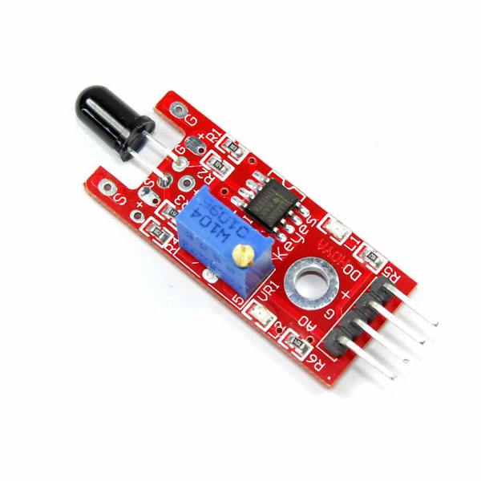
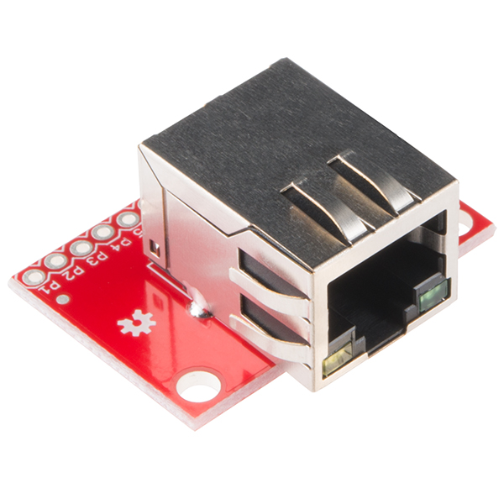
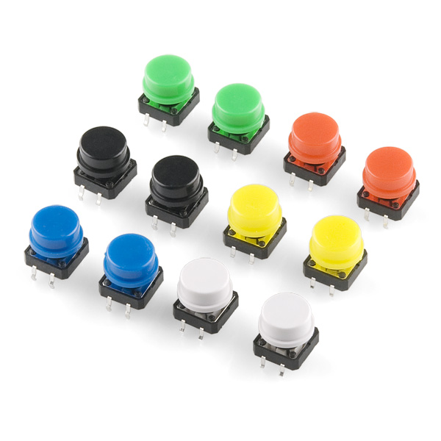
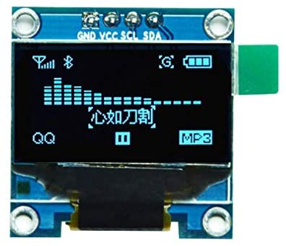
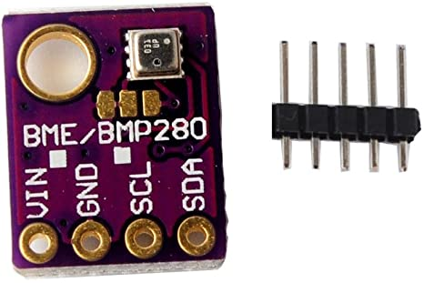
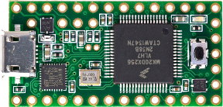
Ethernet Port
Simple Button
12 LED NEOPIXEL
Ky-026 heat sensor
BME temp,humid,pressure sensor
Adafruit OLED
3.1 TEENSY

Slide 4
Challenges Solutions
1.General Coding
2.Box design and functionality
3.Conceptualizing for a larger purpose
4.Coming up with an original idea in general.
1.Spent most of the week working exclusively on coding making sure I created a functioning project, although I still had troubles creating functions that looked and worked well.
2.Created a box that didn’t end up working and ultimately broke, The solution to this problem would have been to spend more time working on a functional piece, and creating something that would work well without having to feel like you're lugging around a large object.
3.While this idea is in no way life changing it does exactly what I wanted/needed it to do to make a certain type of persons life easier.
4.I wanted to create something that I know could and would be used functionally even if it was just for someone close to me.

